Slide 1
Training models: Learning
Jens Peter Andersen, Assistant Professor, Roskilde
Michael Claudius, Associate Professor, Roskilde, with respect and gratefullness to Jens Peter

Slide 2
Learning curves
Purpose: Evaluating a model by comparing performance RMSE on both the training and validation sets
Focus: Overfit and underfit situations

Slide 3
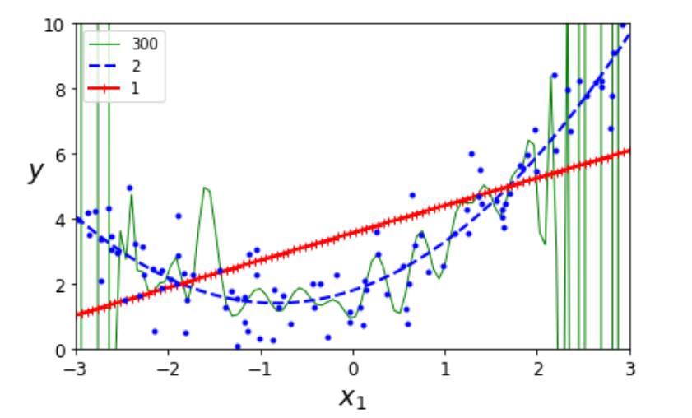
Learning curves - examples
Overfit: Green curve, polynomium degree 300. Performs well on the training set. Will it also perform well on the validation set?
Underfit: Red curve, straight line (polynomium degree 1). Comparable lower performance on both training and validation sets.
Good fit: Blue curve. Polynomium degree 2. Good performance on both training and validation sets.

Slide 4
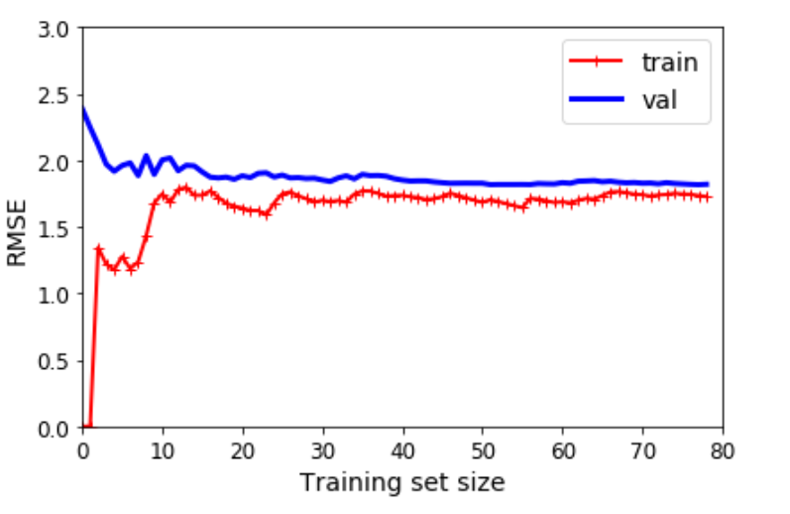
Learning curves – recognizing underfit
Relatively poor performance RMSE on both validation and training sets
Performance RMSE on both validation and training sets are compareable

Slide 5
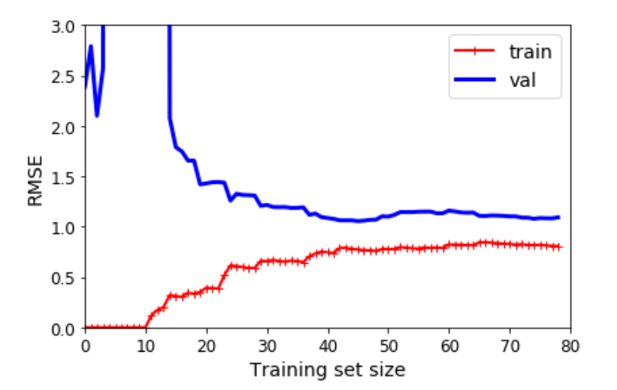
Learning curves – recognizing overfit
Relatively good performance RMSE on the training set and a lot worse both the validation set
Performance RMSE on both validation and training sets are less compareable

Slide 6
Learning curves – comparing underfit and overfit
To the left: Underfit situation - aka high bias
To the right: Overfit situation – aka high variance

Slide 7
Regularized models
Purpose: Avoiding the overfitting situation
Overfitting: Model fits training set well, but fits the validation set badly
Polynomial models: Reduce polynomial degrees
Linear models: Constrain the model parameters θ₁,…,θ_{n} - That is reducing slopes

Slide 8
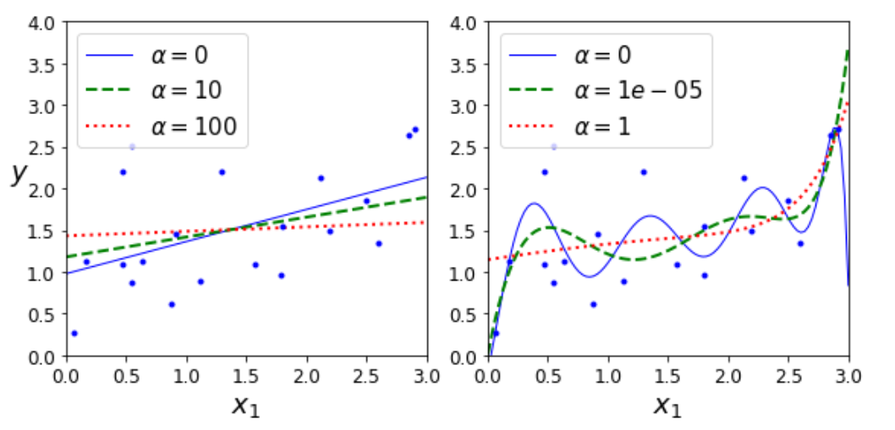
Ridge Regression
Adding a penalty to the cost function MSE during learning only
Keeps models weights as small as possible
Different learning conditions depending ‘penalty factor’ α
Linear model to the left – Polynomial model to the right

Slide 9
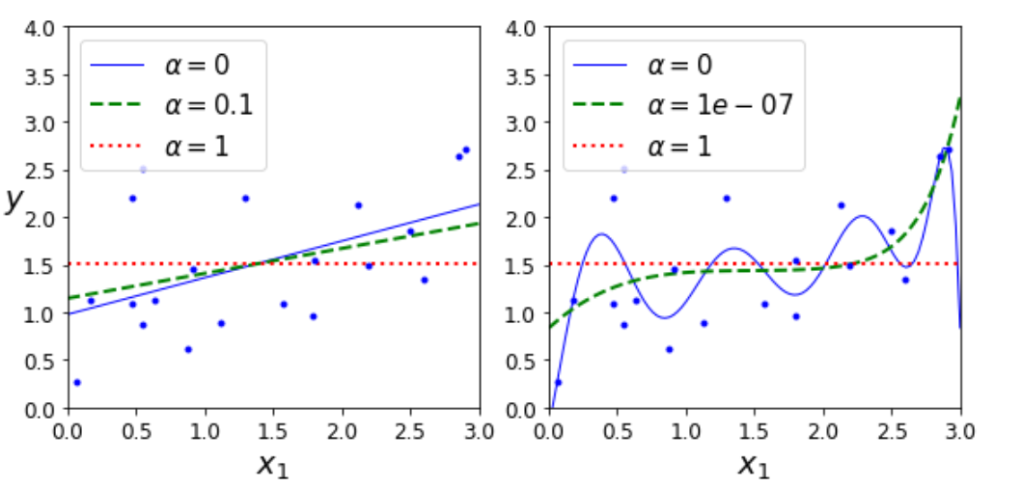
Lasso Regression
Adding a penalty to the cost function MSE during learning only
Eliminates the least important features
Different learning conditions depending ‘penalty factor’ α
Linear model to the left – Polynomial model to the right

Slide 10
Elastic Net
Is a combination of the Ridge and Lasso regression

Slide 11
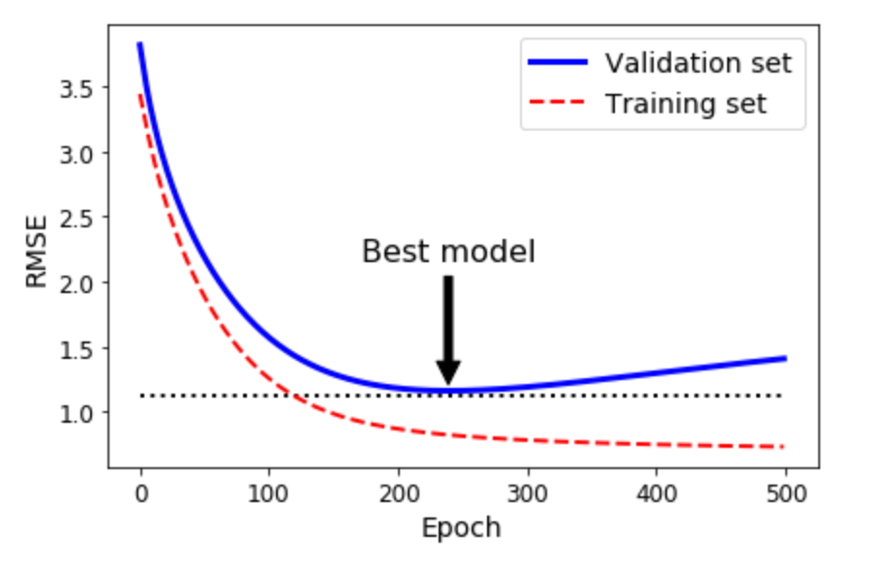
Early Stopping – stop learning when validation is best
Error RMSE when predicting on training set approaches zero
Error RMSE when predicting on the validation set reaches the minimum
The model is best at this minimum
If proceeding further, we will recognize the overfit situation

Slide 12
Early stopping – SGDRegressor example
Available parameters:
early_stopping : bool, default=False Whether to use early stopping to terminate training when validation score is not improving. If set to True, it will automatically set aside a fraction of training data as validation and terminate training when validation score is not improving by at least the value of tol (i.e. tolerance) for n_iter_no_change consecutive epochs.
n_iter_no_change : int, default=5 Number of iterations with no improvement to wait before early stopping.
validation_fraction : float, default=0.1 The proportion of training data to set aside as validation set for early stopping. Must be between 0 and 1. Only used if early_stopping is True.
Source: scikit-learn.org

Slide 13
Learning code
Time to take another look at the code

